Slide 1

CIS 467 :Data Mining
Department of Information Systems
Faculty of Information Technology and Computer Sciences
Yarmouk University – Jordan
© Prof. Dr. Qasem Al-Radaideh
Notes:
1

Slide 2
Topic 1 Introduction to Data Mining
Main Source: J. Han Book
Data Mining: Concepts and Techniques (2nd Ed and 3rd Ed)
(Chapter 1 and Chapter 11)
2
Notes:
2

Slide 3
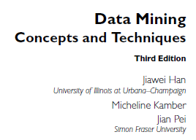
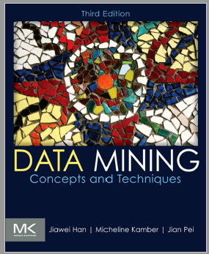


Text Book Page
http://web.engr.illinois.edu/~hanj/
3
Notes:
3

Slide 4
Grading (Since you asked…)
Midterm Exam: 30%
Quizzes/Assignments/Presentation: 20%
Final exam: 50%
Plagiarism ! -100%

Slide 5
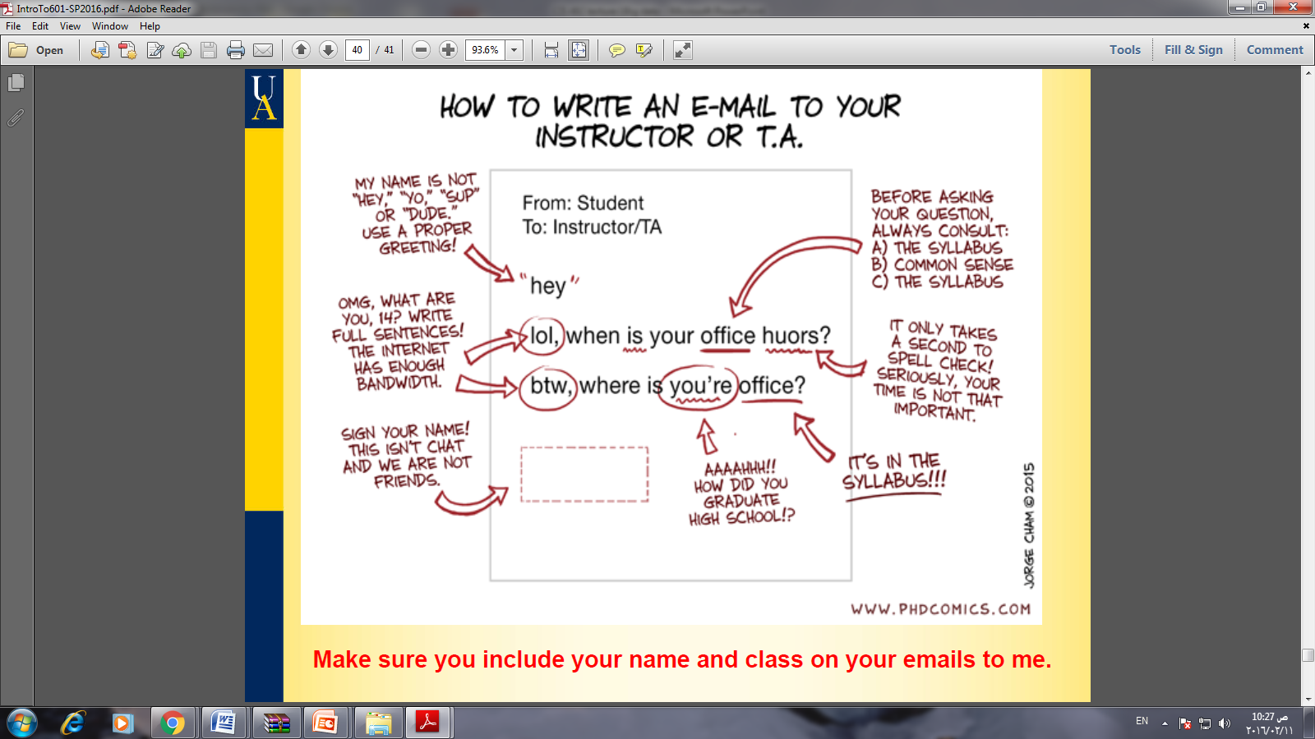
How To Write an E-Mail To your Instructor ☺

Slide 6
Data Science
Cloud Computing
Internet of Things
Big Data
Data Analytics
Disruptive Technologies
Sentiment Analysis

Slide 7
Motivating Students (2):
Think of a way that allow us to predict students marks before the end of the semester?
Think how we can form two teams from the students in the section to participate in a programming competition?
Think of a way that help registration department to know the most frequent courses that are registered together during a semester?
Think ….
Think …
Think …

Slide 8
The Course
This Course is an introduction to the young and fast-growing field of data mining (also known as knowledge discovery from data, or KDD for short).
The Course focuses on fundamental data mining concepts and techniques for discovering interesting patterns from data in various applications.

Slide 9
Topic 1 Introduction to Data Mining
9
Notes:
9

Slide 10
Chapter 1. Introduction
Why Data Mining?
What Is Data Mining?
A Multi-Dimensional View of Data Mining
What Kind of Data Can Be Mined?
What Kinds of Patterns Can Be Mined?
What Technology Are Used?
What Kind of Applications Are Targeted?
Data Mining Tools
Summary

Slide 11
Why Data Mining?
Necessity, who is the mother of invention.
We live in a world where vast amounts of data are collected daily. Analyzing such data is an important need.
Moving toward the Information Age
“We are living in the information age” ???
We are actually living in the data age. Terabytes or petabytes of data pour into our computer networks, the World Wide Web (WWW), and various data storage devices every day from business
We are drowning in data, but starving for knowledge!

Slide 12
The Explosive growth data
This explosive growth of available data volume is a result of the computerization of our society and the fast development of powerful data collection and storage tools.
Global backbone telecommunication networks carry tens of petabytes of data traffic every day. The medical and health industry generates tremendous amounts of data from medical records, patient monitoring, and medical imaging.
Billions of Web searches supported by search engines process tens of petabytes of data daily.

Slide 13
The Explosive growth data
We live in a world where vast amounts of data are collected daily. Analyzing such data is an important need.
First we will look at how data mining can meet this need by providing tools to discover knowledge from data.
Then we will observe how data mining can be viewed as a result of the natural evolution of information technology.

Slide 14
Data Mining
Data mining, also popularly referred to as knowledge discovery from data (KDD), is the automated or convenient extraction of patterns representing knowledge implicitly stored or captured in large databases, data warehouses, the Web, other massive information repositories, or data streams.
Data mining is a multidisciplinary field, drawing work from areas including database technology, machine learning, statistics, pattern recognition, information retrieval, neural networks, Knowledge-based systems, artificial intelligence, high-performance computing, and data visualization.

Slide 15
Data Mining as the Evolution of Information Technology
Data mining can be viewed as a result of the natural evolution of information technology.
The database and data management industry evolved in the development of several critical functionalities.
Data mining emerged during the late 1980s, made great strides during the 1990s, and continues to flourish into the new millennium.

Slide 16
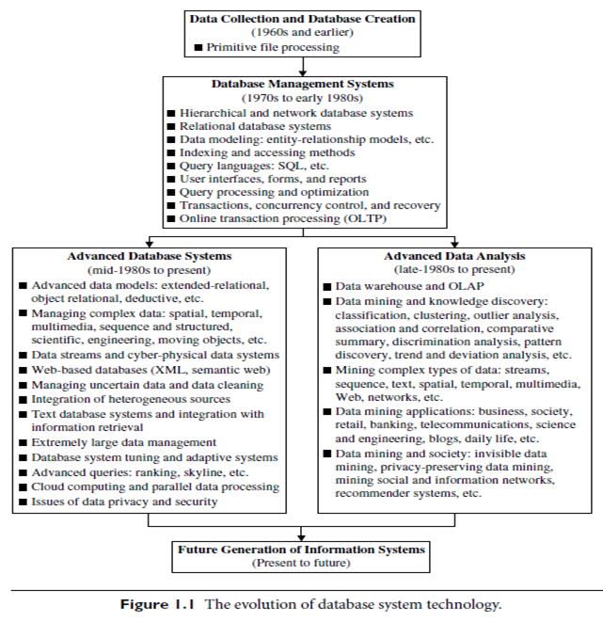

Slide 17
Evolution of Sciences (The early appearance of Data Science)
Before 1600: Empirical Science
1600-1950s: Theoretical Science
Each discipline has grown a theoretical component. Theoretical models often motivate experiments and generalize our understanding.
1950s-1990s: Computational Science
Over the last 50 years, most disciplines have grown a third, computational branch (e.g. empirical, theoretical, and computational ecology, or physics, or linguistics.)
Computational Science traditionally meant simulation. It grew out of our inability to find closed-form solutions for complex mathematical models.
1990-now: Data Science
The flood of data from new scientific instruments and simulations
The ability to economically store and manage petabytes of data online
The Internet and computing Grid that makes all these archives universally accessible
Scientific info. management, acquisition, organization, query, and visualization tasks scale almost linearly with data volumes. Data mining is a major new challenge!

Slide 18
Evolution of Database Technology
See Figure 1.1
1960s:
Data collection, database creation, IMS and network DBMS
1970s:
Relational data model, relational DBMS implementation
1980s:
RDBMS, advanced data models (extended-relational, OO, deductive, etc.)
Application-oriented DBMS (spatial, scientific, engineering, etc.)
1990s:
Data mining, data warehousing, multimedia databases, and Web databases
2000s
Stream data management and mining
Data mining and its applications
Web technology (XML, data integration) and global information systems
Notes:
Two slides should be added after this one
1. Evolution of machine learning
2. Evolution of statistics methods

Slide 19
Data Science
Data Science
Explaining the Past
Predicting the Future
Exploration
Modeling
http://www.saedsayad.com/
Notes:
Two slides should be added after this one
1. Evolution of machine learning
2. Evolution of statistics methods

Slide 20
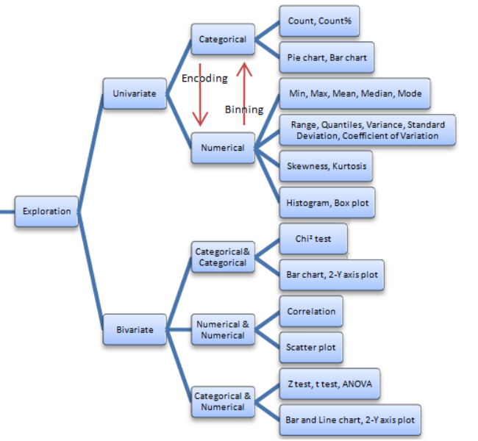
Data Exploration
Notes:
Two slides should be added after this one
1. Evolution of machine learning
2. Evolution of statistics methods

Slide 21
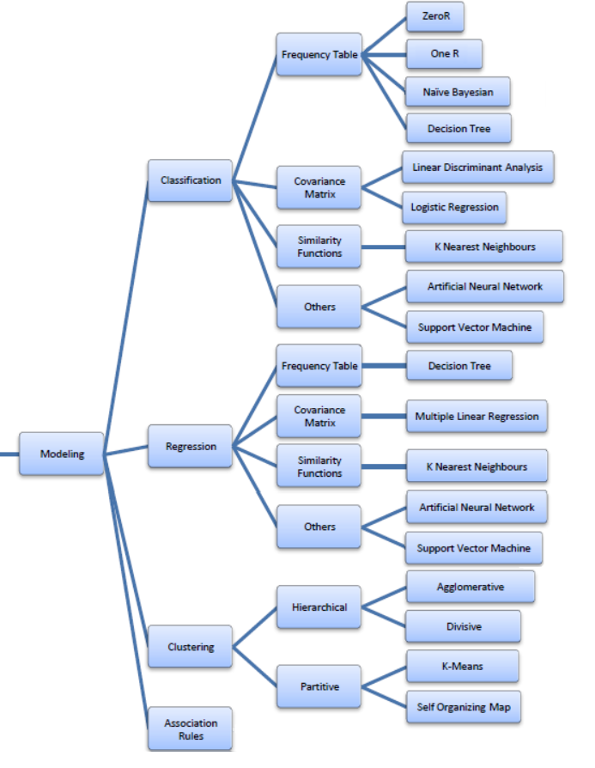
Modelling
Notes:
Two slides should be added after this one
1. Evolution of machine learning
2. Evolution of statistics methods

Slide 22
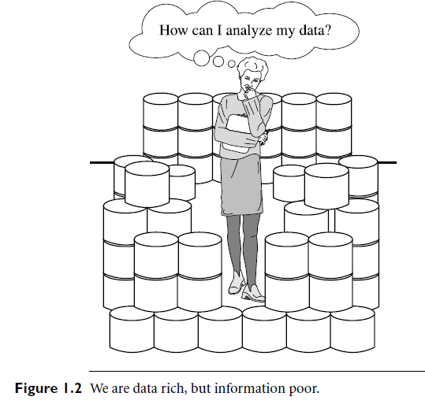
What is Data Mining
It is no surprise that data mining, as a truly interdisciplinary subject, can be defined in many different ways.
Even the term data mining does not really present all the major components in the picture. To refer to the mining of gold from rocks or sand, we say gold mining instead of rock or sand mining.

Slide 23
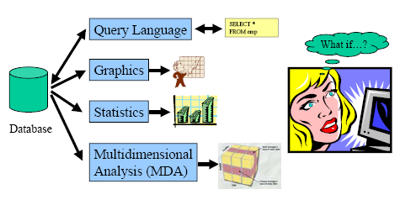
Traditional Data Analysis Methods

Slide 24
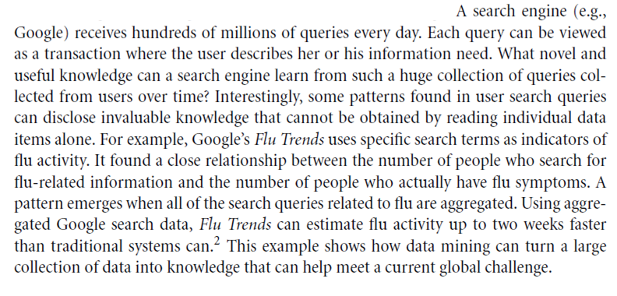
Example : Data mining turns a large collection of data into knowledge.

Slide 25
DM and KDD
Note:
We agree that data mining DM is a step in the knowledge discovery process KDD.
However, in industry, in media, and in the database research milieu, the term data mining is becoming more popular than the longer term of knowledge discovery from data.
Now Data Analysis is more popular.

Slide 26
1.2 What Is Data Mining?
Formal Definition of DM:
Data mining (knowledge discovery from data)
Extraction of interesting (non-trivial, implicit, previously unknown and potentially useful) patterns or knowledge from huge amount of data
Data mining: a misnomer?
The term is actually a misnomer. Remember that the mining of gold from rocks or sand is referred to as gold mining rather than rock or sand mining.
Thus, data mining should have been more appropriately named “knowledge mining from data,” which is unfortunately somewhat long. “Knowledge mining,” a shorter term, may not reflect the emphasis on mining from large amounts of data.

Slide 27
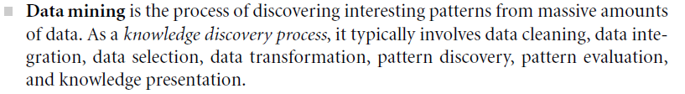
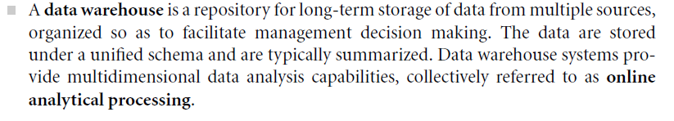
Basic Terms

Slide 28
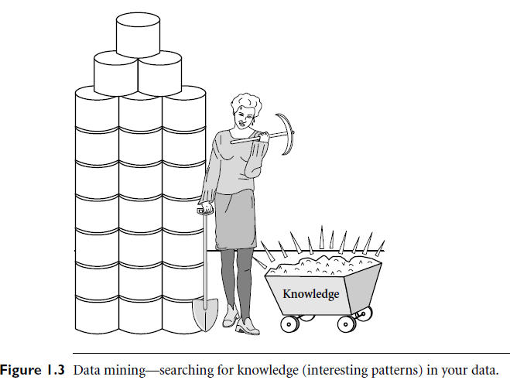
Nice Illustrative Figure of Data Mining
Data
Data Analyst (Miner)
Data Mining Tools and Functions
Extracted Knowledge (Gold)

Slide 29
Knowledge Discovery (KDD) Process From Data to Knowledge

Slide 30
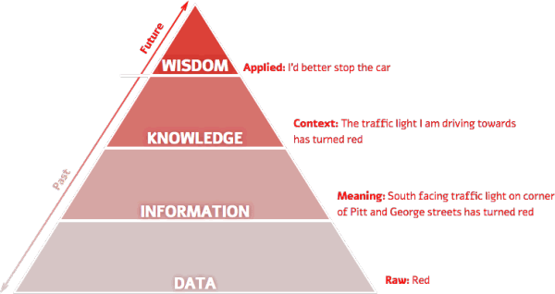
From Data to Knowledge

Slide 31
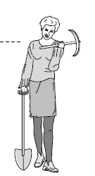
Knowledge Discovery (KDD) Process
Knowledge
This is a view from typical database systems and data warehousing communities
Data mining plays an essential role in the knowledge discovery process
Pattern Evaluation
Data Mining
Task-relevant Data
Data Warehouse
Selection
Data Cleaning
Data Integration
Databases

Slide 32
Knowledge Discovery (KDD) Process
Knowledge discovery as a process is depicted in Figure 1.4 and consists of an iterative sequence of the following steps:
1. Data cleaning: to remove noise and inconsistent data)
2. Data integration: where multiple data sources may be combined
3. Data selection: where data relevant to the analysis task are retrieved from the database
4. Data transformation: where data are transformed or consolidated into forms appropriate for mining by performing summary or aggregation operations, for instance
5. Data mining: an essential process where intelligent methods are applied in order to extract data patterns.
Choosing functions of data mining: summarization, classification, regression, association, clustering
Choosing the mining algorithm (s)
6. Pattern evaluation: to identify the truly interesting patterns representing knowledge based on some interestingness measures; (Section 1.5)
7. Knowledge presentation: where visualization and knowledge representation techniques are used to present the mined knowledge to the user
Note: Steps 1 to 4 are different forms of data preprocessing, where the data are prepared for mining.

Slide 33
KDD Process: A Typical View from ML and Statistics
Pattern
Information
Knowledge
Input Data
Data Pre-Processing
Data Mining
Post-Processing
Data Cleaning
Data integration
Normalization
Feature selection
Dimension reduction …
Pattern discovery
Association & correlation
Classification
Clustering
Outlier analysis
… … … …
Pattern evaluation
Pattern selection
Pattern interpretation
Pattern visualization …
This is a view from typical machine learning and statistics communities

Slide 34
Examples of Data Mining Findings
Some examples of data mining findings:
Example 1)
75% of customers who bought TV 35” or larger are 85% likely to buy a home-theater system within the next five weeks.
(In class discussion)
Example 2)
If income <= 35000 and credit_rating < 3 and age < 35 and credit_amount > 50000 then minimum loan term is 5 years.
Exercise: Students should think of more practical examples from their environments.

Slide 35
Aspects of Data Mining (A multi-dimensional View of Data Mining)
1.3 What Kinds Data can be mined
Database data (extended-relational, object-oriented, heterogeneous, legacy), data warehouse, transactional data, stream, spatiotemporal, time-series, sequence, text and web, multi-media, graphs & social and information networks
1.4 What kinds of patterns to be mined (Data mining functions/tasks)
Characterization, discrimination, association, classification, clustering, trend/deviation, outlier analysis, etc.
Descriptive vs. predictive data mining
Multiple/integrated functions and mining at multiple levels
1.5 Which technologies are used
Data-intensive, data warehouse (OLAP), machine learning, statistics, pattern recognition, visualization, high-performance, etc.
1.6 Which Kinds of Applications Are Targeted
Retail, telecommunication, banking, fraud analysis, bio-data mining, stock market analysis, text mining, Web mining, etc.

Slide 36
1.3 What Kinds Data can be mined?
Database-oriented data sets and applications
Relational database, data warehouse, transactional database
Advanced data sets and advanced applications
A relational database is a collection of tables, each of which is assigned a unique name.
A data warehouse is a repository of information collected from multiple sources, stored under a unified schema, and that usually resides at a single site.
A data cube provides a multidimensional view of data and allows the pre-computation and fast accessing of summarized data.
Object-relational databases are constructed based on an object-relational data model
A transactional database consists of a file where each record represents a transaction
A temporal database typically stores relational data that include time-related attributes
A sequence database stores sequences of ordered events
A time-series database stores sequences of values or events obtained over repeated measurements of time
Spatial databases contain spatial-related information
Text databases are databases that contain word descriptions for objects
Multimedia databases store image, audio, and video data
A legacy database is a group of heterogeneous databases that combines different kinds of data systems
Note: Fore more details and definitions of these kinds of data, refer to book pages 10 to 21

Slide 37
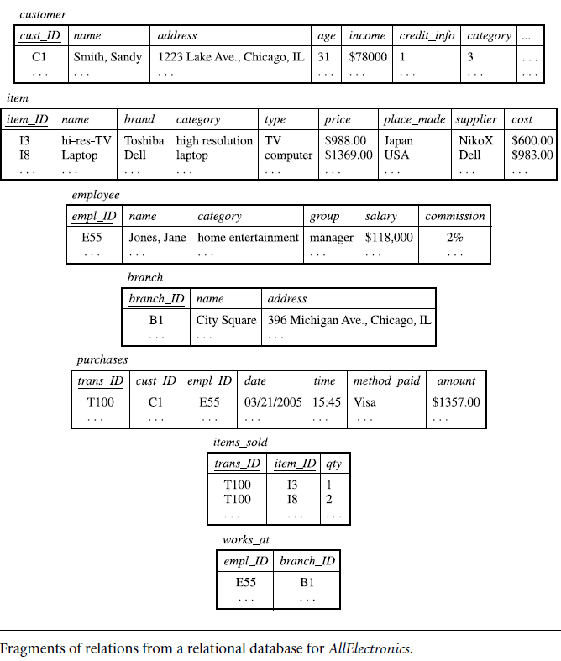
Example of Relational Database

Slide 38
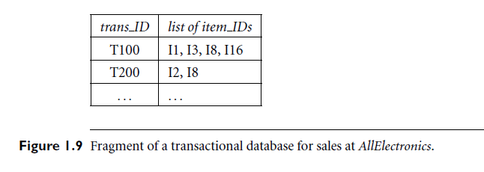
Example of Transactional Database

Slide 39
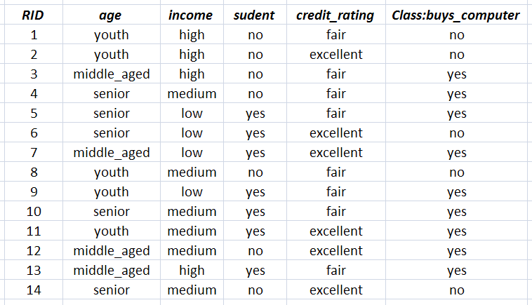
Example of a Flat Dataset
The Buys Computer Dataset: This follows an example from Quinlan’s ID3

Slide 40
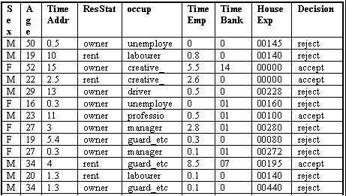
Example of a Flat Dataset

Slide 41
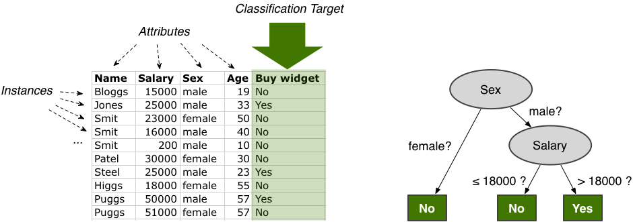
Example of a Flat Dataset
Extracted Knowledge represented as a Decision Tree

Slide 42
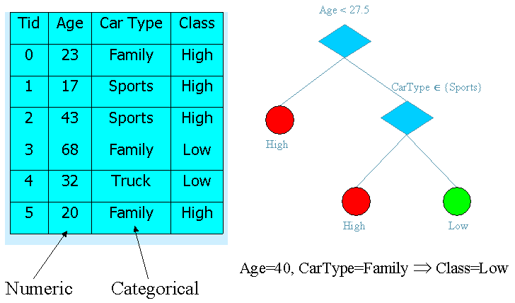
Example of a Dataset
Extracted Knowledge represented as a Decision Tree and Rules

Slide 43
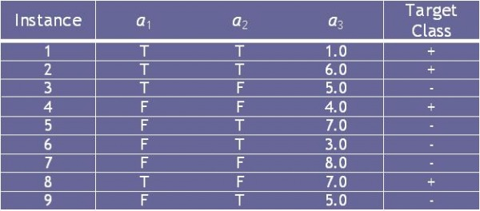
Example of a Dataset with some Boolean Attributes

Slide 44
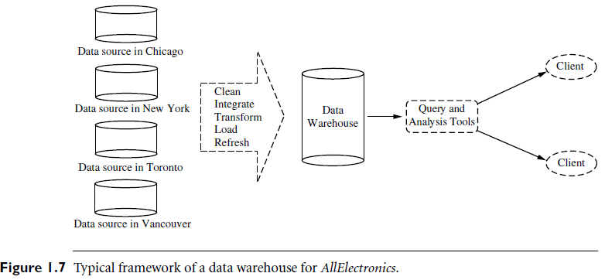
An Example of a Data Warehouse

Slide 45
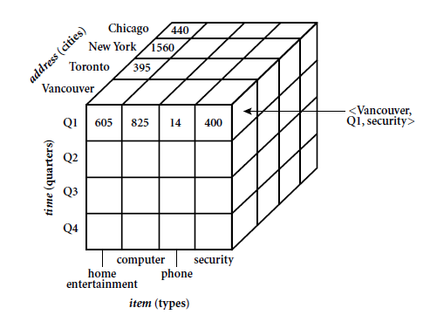
An Example of a Data Cube

Slide 46
Ex: Multidimensional Data
Sales volume as a function of product, month, and region
Dimensions: Product, Location, Time
Hierarchical summarization paths
Region
Industry Region Year
Category Country Quarter
Product City Month Week
Office Day
Product
Month

Slide 47
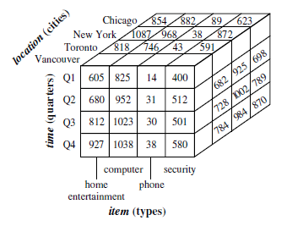
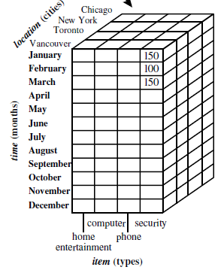

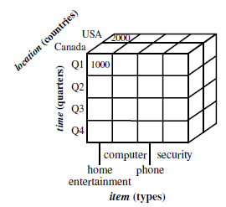

An Example of Data Cube operations

Slide 48
1.4 What Kinds of Patterns Can Be Mined? (Data Mining Functionalities/tasks)
We have observed various types of databases and information repositories on which data mining can be performed. Let us now examine the kinds of data patterns that can be mined. Data mining functionalities are used to specify the kind of patterns to be found in data mining tasks.
In general, data mining tasks can be classified into two categories:
Descriptive mining tasks: characterize the general properties of the data in the database.
Predictive mining tasks: perform inference on the current data in order to make predictions.
Example: Results of Data Mining May Include:
Forecasting what may happen in the future
Classifying people or things into groups by recognizing patterns
Clustering people or things into groups based on their attributes
Associating what events are likely to occur together
Sequencing what events are likely to lead to later events

Slide 49
Data Mining Models and Tasks
Data Mining
Predictive
Descriptive
Classification
Regression
Clustering
Association Rules
Prediction
Time Series Analysis
Sequence Discovery
Summarisation
49

Slide 50
1.4.1 Concept/Class Description: Characterization and Discrimination
Data can be associated with classes or concepts. For example, in the AllElectronics store, classes of items for sale include computers and printers, and concepts of customers include big-Spenders and budget-Spenders.
Such descriptions of a class or a concept are called class/concept descriptions. These descriptions can be derived via:
(1) data characterization, by summarizing the data of the class under study (often called the target class) in general terms, or
(2) data discrimination, by comparison of the target class with one or a set of comparative classes (often called the contrasting classes), or
(3) both data characterization and discrimination.
Data characterization is a summarization of the general characteristics or features of a target class of data.
Example : study the characteristics of software products whose sales increased by 10% in the last year.
The output of data characterization can be presented in various forms. Examples : include pie charts, bar charts, curves, multidimensional data cubes, and multidimensional tables.
The resulting descriptions can also be presented as generalized relations or in rule form(called characteristic rules).

Slide 51
1.4.1 Concept/Class Description: Characterization and Discrimination
Data discrimination is a comparison of the general features of target class data objects with the general features of objects from one or a set of contrasting classes.
Example: the user may like to compare the general features of software products whose sales increased by 10% in the last year with those whose sales decreased by at least 30% during the same period.
Discrimination descriptions expressed in rule form are referred to as discriminant rules.

Slide 52
1.4.2 Mining Frequent Patterns, Associations, and Correlations
Frequent patterns are patterns that occur frequently in data. A frequent itemset typically refers to a set of items that frequently appear together in a transactional data set, such as milk and bread.
What is Association Mining?
Finding frequent patterns, associations, correlations, or causal structures among sets of items or objects in transaction databases, relational databases, and other information repositories
Frequent pattern: pattern (set of items, sequence, etc) that occurs frequently in database
Example of typical association rules:
Diaper → Beer [0.5%, 75%] (support, confidence)
Issues:
1) How to mine such patterns and rules efficiently in large datasets?
2) How to use such patterns for classification, clustering, and other applications?

Slide 53
1.4.3 Classification and Predication
Classification is the process of finding a model (or function) that describes and distinguishes data classes or concepts, for the purpose of being able to use the model to predict the class of objects whose class label is unknown.
The derived model is based on the analysis of a set of training data (i.e., data objects whose class label is known). Describe and distinguish classes or concepts for future prediction.
Examples:
Classify countries based on (climate),
Classify cars based on (gas mileage)
The derived model may be represented in various forms, such as classification (IF-THEN) rules, decision trees, mathematical formulae, or neural networks
Typical methods
Decision trees, naïve Bayesian classification, support vector machines, neural networks, rule-based classification, pattern-based classification, logistic regression, …
Typical applications:
Credit card fraud detection, direct marketing, classifying stars, diseases, web-pages, …
Prediction: models continuous-valued functions. That is, it is used to predict missing or unavailable numerical data values rather than class labels.

Slide 54
Example of a Flat Dataset
The Buys Computer Dataset: This follows an example from Quinlan’s ID3

Slide 55
The Output of classification task using Decision Tree method for “buys_computer” class
Example: A Decision Tree
age?
A decision tree is a flow-chart-like tree structure, where each node denotes a test on an attribute value, each branch represents an outcome of the test, and tree leaves represent classes or class distributions.
Decision trees can easily be
converted to classification rules.
Example : If Age = 30..40 Then Buys_Computer = yes.
<=30
overcast
>40
30..40
student?
yes
credit rating?
no
yes
excellent
fair
no
yes
no
yes

Slide 56
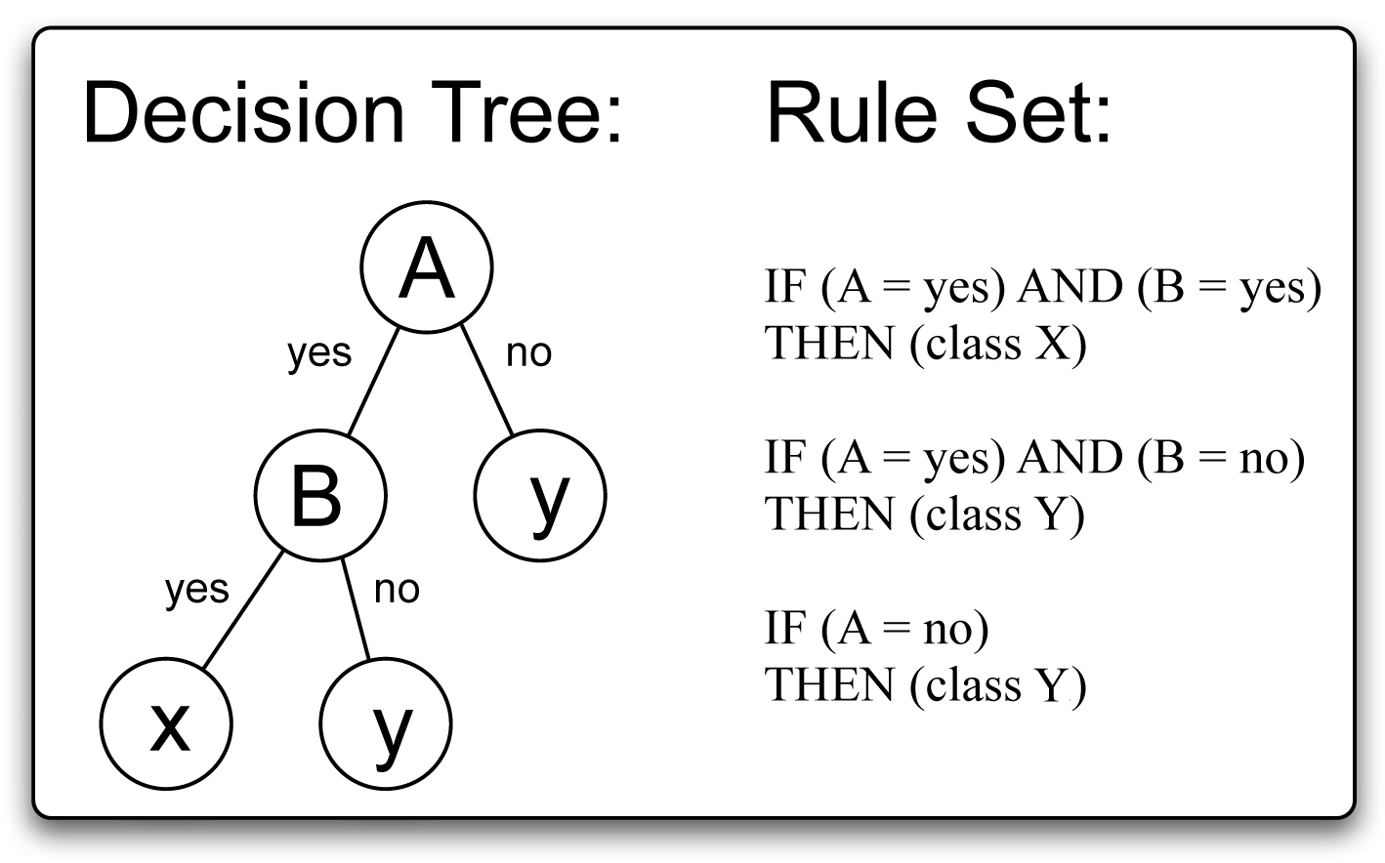
Example (2) : A Decision Tree

Slide 57
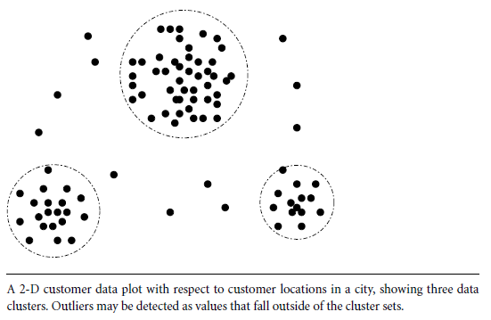
1.4.4 Cluster Analysis
Unsupervised learning (i.e., Class label is unknown)
Group data to form new categories (i.e., clusters),
Example: cluster houses to find distribution patterns
Principle: Maximizing intra-class similarity & minimizing interclass similarity
Many methods and applications
Cluster

Slide 58
1.4.5 Outlier Analysis
Outlier: A data object that does not comply with the general behavior of the data
Noise or exception? ― One person’s garbage could be another person’s treasure
Methods: by product of clustering or regression analysis, …
Useful in fraud detection, rare events analysis
Outlier

Slide 59
1.4.6 Are All the “Discovered” Patterns Interesting?
Data mining may generate thousands of patterns: Not all of them are interesting
Suggested approach: Human-centered, query-based, focused mining
Interestingness measures
A pattern is interesting if it is easily understood by humans, valid on new or test data with some degree of certainty, potentially useful, novel, or validates some hypothesis that a user seeks to confirm
Objective vs. subjective interestingness measures
Objective: based on statistics and structures of patterns, e.g., support, confidence, etc.
Subjective: based on user’s belief in the data, e.g., unexpectedness, novelty, actionability, etc.

Slide 60

1.4.6 Evaluation of Knowledge
Evaluation of mined knowledge → directly mine only interesting knowledge?
Descriptive vs. predictive
Coverage
Typicality vs. novelty
Accuracy
Timeliness
…

Slide 61

Break

Slide 62
1.6 Which Technologies Are Used?
Data mining is an interdisciplinary field, the confluence of a set of disciplines, including database systems, statistics, machine learning, visualization, and information science (Figure 1.12).
Moreover, depending on the data mining approach used, techniques from other disciplines may be applied, such as neural networks, fuzzy and/or rough set theory, knowledge representation, inductive logic programming, or high-performance Computing.
Depending on the kinds of data to be mined or on the given data mining application, the data mining system may also integrate techniques from spatial data analysis, information retrieval, pattern recognition, image analysis, signal processing, computer graphics, Web technology, economics, business, bioinformatics, or psychology.
See Next figure

Slide 63
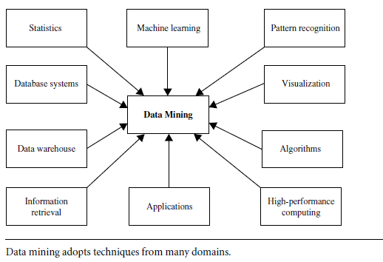
Data Mining is A confluence of Disciplines
Data mining involves an integration of techniques from multiple disciplines such as database and data warehouse technology, statistics, machine learning, high-performance computing, pattern recognition, neural networks, data visualization, information retrieval, image and signal processing, and spatial or temporal data analysis.

Slide 64
Why Confluence of Multiple Disciplines?
Tremendous amount of data
Algorithms must be highly scalable to handle such as tera-bytes of data
High-dimensionality of data
Some Data may have tens of thousands of dimensions
High complexity of data
Data streams and sensor data
Time-series data, temporal data, sequence data
Structure data, graphs, social networks and multi-linked data
Heterogeneous databases and legacy databases
Spatial, spatiotemporal, multimedia, text and Web data
Software programs, scientific simulations
New and sophisticated applications
Notes:
Add a definition/description of “traditional data analysis”.

Slide 65
1.6 Which Kinds of Applications Are Targeted?
Where there are data, there are data mining applications.
As a young research field, data mining has made broad and significant progress since its early beginnings in the 1980s.
Today, data mining is used in a vast array of areas, and numerous commercial data mining systems are available.
As a highly application-driven discipline, data mining has seen great successes in many applications. It is impossible to enumerate all applications where data mining plays a critical role.
Notes:
Add a definition/description of “traditional data analysis”.

Slide 66
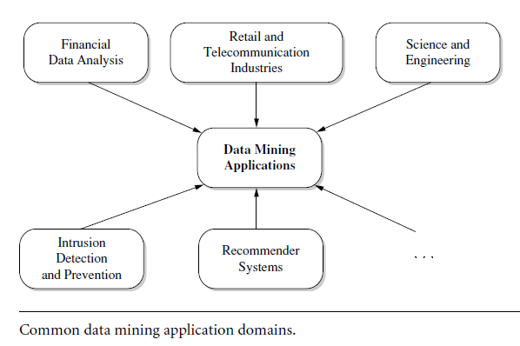
1.6 Which Kinds of Applications Are Targeted?
1.6.1 Business Intelligence
1.6.2 Web Search Engines
…..
….

Slide 67
Business Intelligence
Business intelligence (BI) technologies provide historical, current, and predictive views of business operations. Examples include reporting, online analytical processing, business performance management, competitive intelligence, benchmarking, and predictive analytics.
Without data mining, many businesses may not be able to perform effective market analysis, compare customer feedback on similar products, discover the strengths and weaknesses of their competitors, retain highly valuable customers, and make smart business decisions.
Clearly, data mining is the core of business intelligence. Online analytical processing tools in business intelligence rely on data warehousing and multidimensional data mining. Classification and prediction techniques are the core of predictive analytics in business intelligence, for which there are many applications in analyzing markets, supplies, and sales. Moreover, clustering plays a central role in customer relationship management, which groups customers based on their similarities. Using characterization mining techniques, we can better understand features of each customer group and develop customized customer reward programs.

Slide 68
Data Mining in Business Intelligence
Increasing potential
to support
business decisions
End User
Decision Making
Data Presentation
Business
Analyst
Visualization Techniques
Data Mining
Data
Analyst
Information Discovery
Data Exploration
Statistical Summary, Querying, and Reporting
Data Preprocessing/Integration, Data Warehouses
Data Sources
DBA
Paper, Files, Web documents, Scientific experiments, Database Systems

Slide 69
More Applications and Cases will be discussed at the last topic of this course

Slide 70


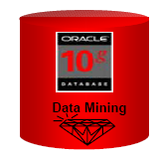





Data Mining Software Tools
Commercial Products
SAS Enterprise Miner
SPSS Clementine
IBM Intelligent Miner
SGI MineSet
i2 Analyst’s Notebook
Microsoft OLE DB for Data Mining
Oracle Data Mining
Free and open Source Products.
Weka
Rapid Miner
Orange
Knime
And Now PYTHON

Slide 71
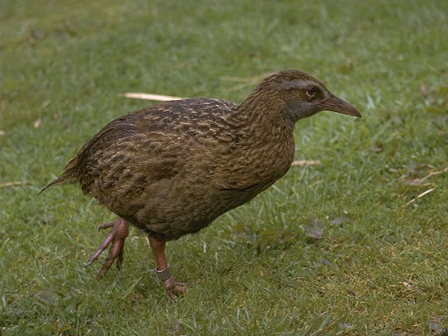
Example 1: WEKA - Data Mining Software
WEKA is a collection of machine learning algorithms for data mining tasks.
The algorithms can either be applied directly to a dataset or called from your own Java code.
Weka contains tools for data pre-processing, classification, regression, clustering, association rules, and visualization.
Weka is open source software in JAVA issued under the GNU General Public License.
http://www.cs.waikato.ac.nz/ml/weka/

Slide 72

Example 2: Rapid Miner - Data Mining Software
RapidMiner is a software platform for analytics teams that unites data prep, machine learning, and predictive model deployment.
Try It
https://rapidminer.com/

Slide 73

Example 3: PYTHON for Data Science
PYTHON is an interpreted, object-oriented, high-level programming language with dynamic semantics. Its high-level built in data structures, combined with dynamic typing and dynamic binding, make it very attractive for Rapid Application Development, as well as for use as a scripting or glue language to connect existing components together. Python's simple, easy to learn syntax emphasizes readability and therefore reduces the cost of program maintenance. Python supports modules and packages, which encourages program modularity and code reuse. The Python interpreter and the extensive standard library are available in source or binary form without charge for all major platforms, and can be freely distributed.
You can find some books related to using PYTHON for Data Science.
CIS 467L (Data Mining Lab)
https://www.python.org/

Slide 74
Summary
Data mining: Discovering interesting patterns and knowledge from massive amount of data
A natural evolution of database technology, in great demand, with wide applications
A KDD process includes data cleaning, data integration, data selection, transformation, data mining, pattern evaluation, and knowledge presentation
Mining can be performed in a variety of data
Data mining functionalities: characterization, discrimination, association, classification, clustering, outlier and trend analysis, etc.
Data mining technologies and applications

Slide 75
Some Pioneers in the Data Mining Field
U. M. Fayyad,
G. Piatetsky-Shapiro,
J. Han
I. H. Witten
E. Frank
Motivate students to Find More >>>>>>

Slide 76
Say some thing about the Course Lab CIS 467L

Slide 77
Exercises
1.1 What is data mining? In your answer, address the following:
(a) Is it another hype?
(b) Is it a simple transformation of technology developed from databases, statistics, and
machine learning?
(c) Explain how the evolution of database technology led to data mining.
(d) Describe the steps involved in data mining when viewed as a process of knowledge
discovery.
1.6 Define each of the following data mining functionalities: characterization, discrimination, association and correlation analysis, classification, prediction, clustering, and evolution analysis. Give examples of each data mining functionality, using a real-life database with which you are familiar.
1.11 Outliers are often discarded as noise. However, one person’s garbage could be another’s treasure. For example, exceptions in credit card transactions can help us detect the fraudulent use of credit cards. Taking fraudulence detection as an example, propose two methods that can be used to detect outliers and discuss which one is more reliable.

